Slide 1

Deep Learning-Based Smart Real-Time Emergency Resource Allocation and Inventory Monitoring System MLA0408-Deep Learning
GUIDED BY:
Dr D Sudhagar, SIMATS ENGINEERING
CHENNAI
PRESENTED BY:
G Vishnu Madhav (192425192)
S Mahammed Nayeem (192425294)
M MD Rehan (192425391)
Department of AIML
SIMATS ENGINEERING
CHENNAI

Slide 2



Agenda
Introduction
Objectives
Literature Review
Problem statement
Architecture diagram
Modules
Algorithm used
Implementation
Conclusion
Future scope
References

Slide 3
Abstract
This project presents a Deep Learning-Based Smart Real-Time Emergency Resource Allocation and Inventory Monitoring System aimed at improving the efficiency and responsiveness of emergency management. The system leverages deep learning models to analyze historical and real-time data, enabling accurate prediction of resource demand during critical situations such as natural disasters or accidents. Its primary objective is to optimize the allocation of essential resources such as medical supplies, rescue equipment.

Slide 4
Introduction
Increasing number of natural disasters, accidents, and medical emergencies.
Emergency response systems often face delays and inefficient resource allocation.
Traditional emergency management methods are not effective for dynamic real-time situations.
LSTM is used for emergency resource demand prediction.
GRU is used for ETA (Estimated Time of Arrival) and travel time prediction.
This project develops a smart real-time system for efficient emergency resource allocation and inventory monitoring.

Slide 5



Objectives
Develop a deep learning-based system (LSTM–GRU) for accurate emergency resource demand prediction.
Utilize historical and real-time data to forecast demand and estimate vehicle travel time (ETA).
Design a smart resource allocation mechanism based on predicted demand and real-time availability.
Enable efficient dispatch planning using ETA predictions to minimize delays.
Ensure dynamic tracking and coordination of resources across multiple locations.

Slide 6
Literature survey
S. No. | Author(s) & Year | Dataset Used | Algorithms / Methods | Feature Extraction | Key Findings | Limitations
1 | S. Patel et al. (2024) | Emergency Response Dataset | Reinforcement Learning | State-action features | RL optimized dynamic resource allocation in real-time scenarios | High training complexity
2 | M. Lee et al. (2024) | Multi-source Disaster Data | Hybrid DL Models (CNN + LSTM) | Temporal + spatial features | Hybrid models enhanced prediction of disaster impact and resource needs | Computational cost is high
3 | P. Singh et al. (2024) | Logistics & Supply Chain Dataset | Optimization Algorithms + DL | Demand patterns | Improved resource distribution efficiency across multiple locations | Limited scalability in large-scale disasters
4 | R. Kumar et al. (2023) | Disaster Management Dataset | CNN, LSTM | Spatio-temporal features | Deep learning models improved prediction accuracy of resource demand in emergencies | Limited real-time deployment

Slide 7
Problem statement
Increasing number of emergencies and disasters require fast and efficient response systems.
Delays in resource allocation can increase loss of life and property.
Lack of real-time inventory monitoring leads to resource shortages and overstocking.
Existing systems have poor coordination between emergency units and resource centers.
Traffic conditions and travel delays affect emergency vehicle response time.
Traditional methods cannot accurately predict emergency resource demand in real-time.

Slide 8
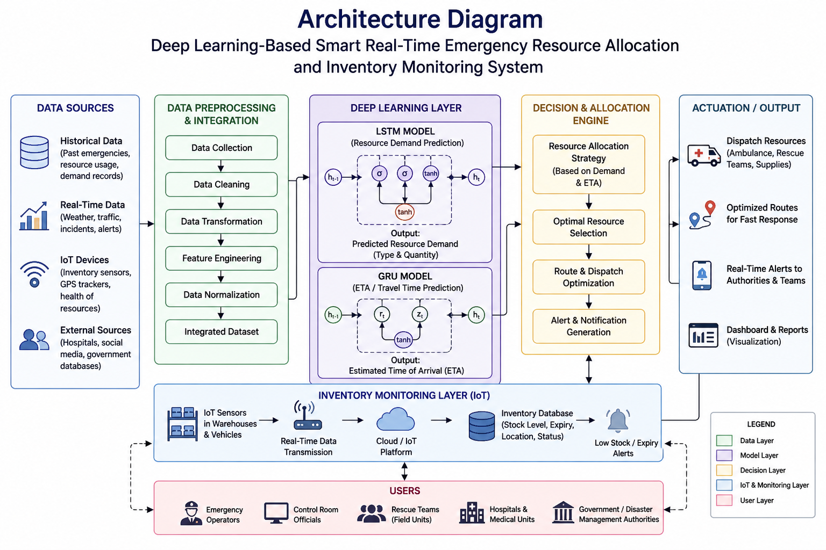
Architecture diagram

Slide 9
Algorithms Used
Long short term memory(LSTM) :
A type of recurrent neural network designed for time-series data analysis.
Captures long-term dependencies using memory cells and gates.
Handles sequential data like historical emergency records.
Used to predict resource demand and emergency severity.
Gated Recurrent Unit (GRU) :
A simplified version of LSTM with fewer parameters and faster computation.
Efficient in processing real-time sequential data.
Captures important patterns using update and reset gates.
Used to predict vehicle travel time (ETA) and response delays.

Slide 10


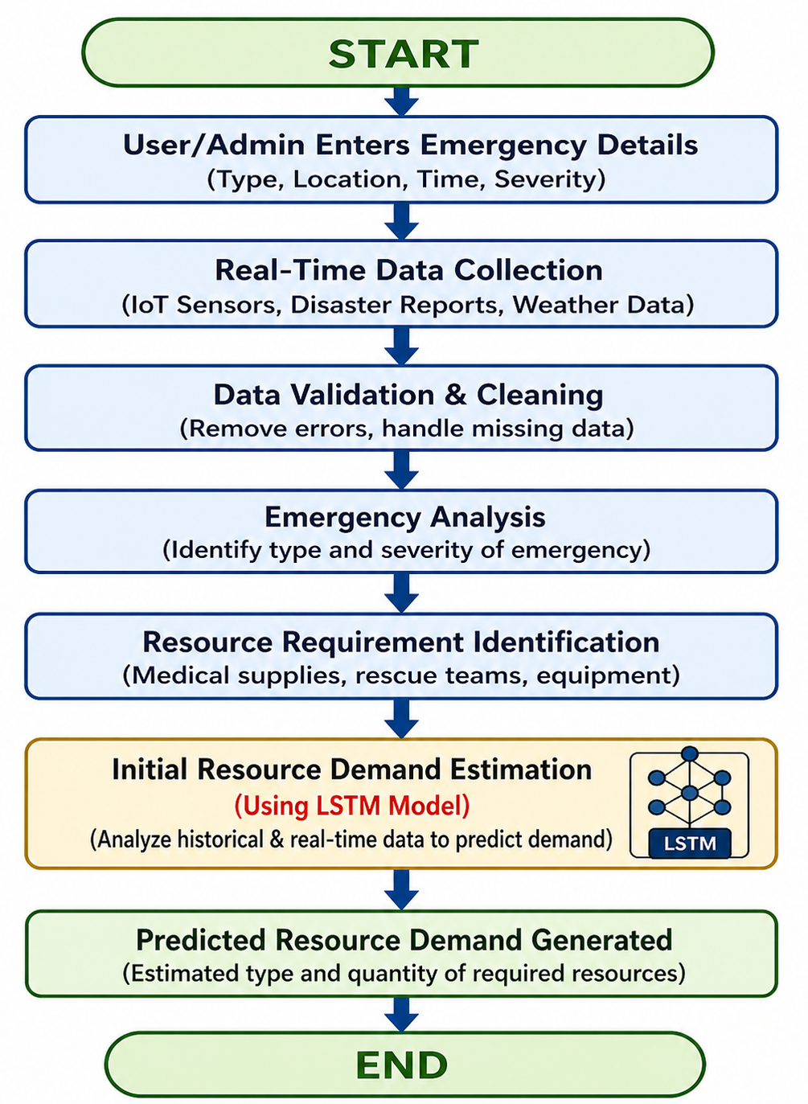
Module 1:Emergency Request & Resource Demand
Collect emergency details and real-time data
Preprocess and validate input data
Use LSTM algorithm for resource demand prediction.
LSTM analyzes historical and sequential emergency data.
Predict required resources based on emergency severity and patterns.
Generate estimated demand for resource allocation and dispatch.

Slide 11
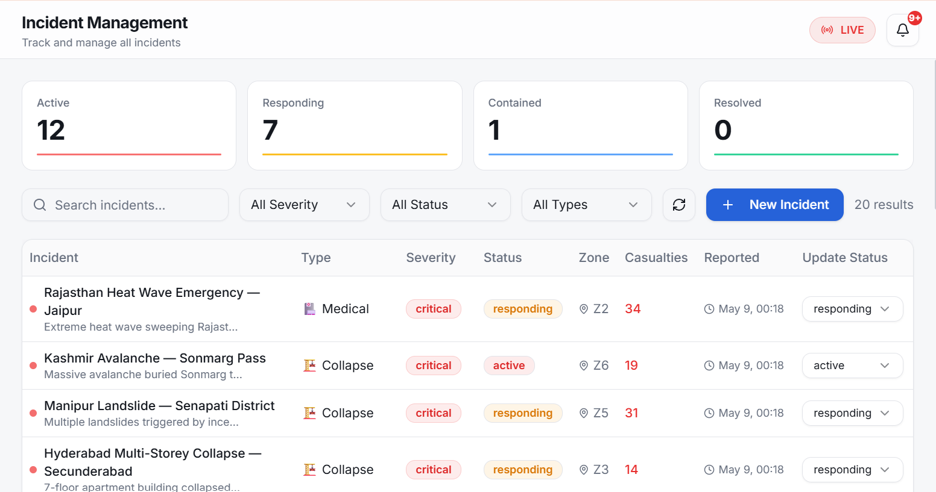
Output

Slide 12
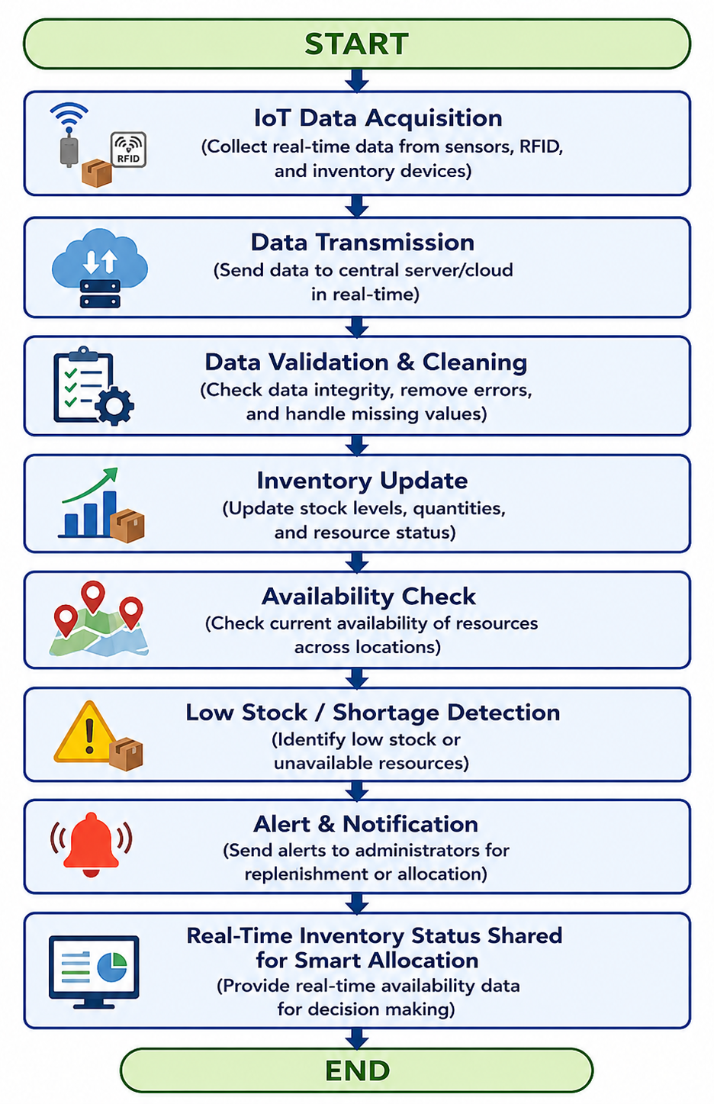
Module 2:Inventory Monitoring & Availability
Monitor real-time availability of emergency resources using IoT sensors and RFID devices.
Track stock levels of medical supplies, rescue equipment, and emergency vehicles.
Detect low stock, shortages, and unavailable resources automatically.
Update inventory status continuously across multiple locations.
Provide real-time inventory data for efficient resource allocation and dispatch decisions.

Slide 13
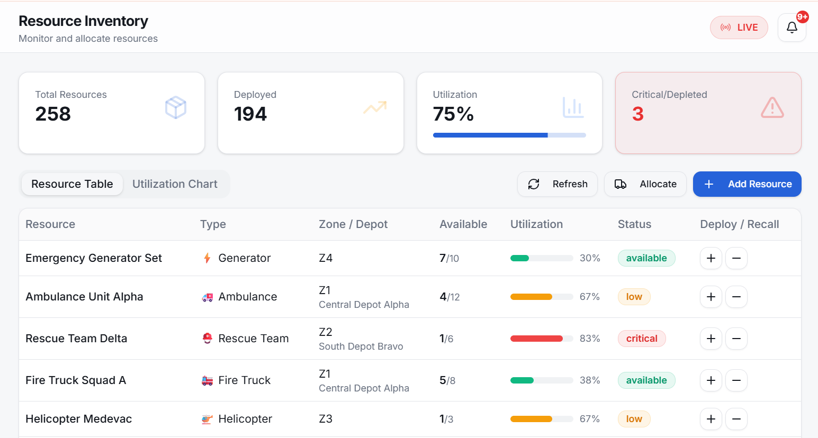
Output

Slide 14
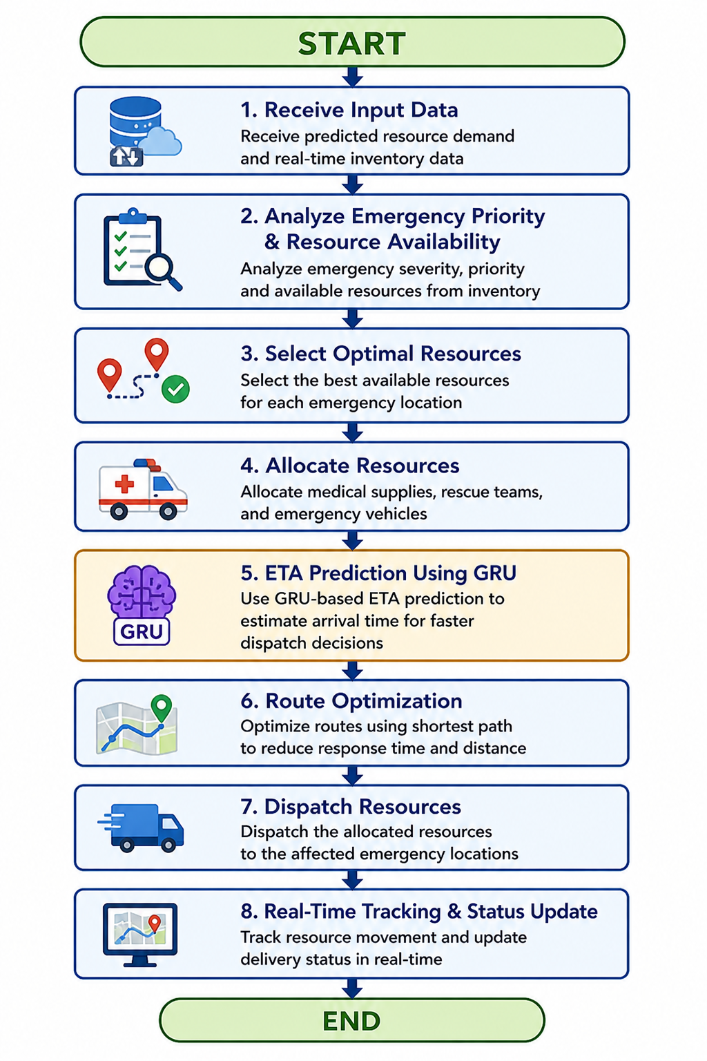
Module 3:Smart Allocation & Dispatch
Receive predicted resource demand and real-time inventory data.
Analyze emergency priority and resource availability.
Select optimal resources for each emergency location.
Allocate medical supplies, rescue teams, and emergency vehicles.
Use GRU-based ETA prediction for faster dispatch decisions.
Optimize routes to reduce response time.
Dispatch resources to affected emergency locations.
Track resource movement and delivery status in real-time.

Slide 15
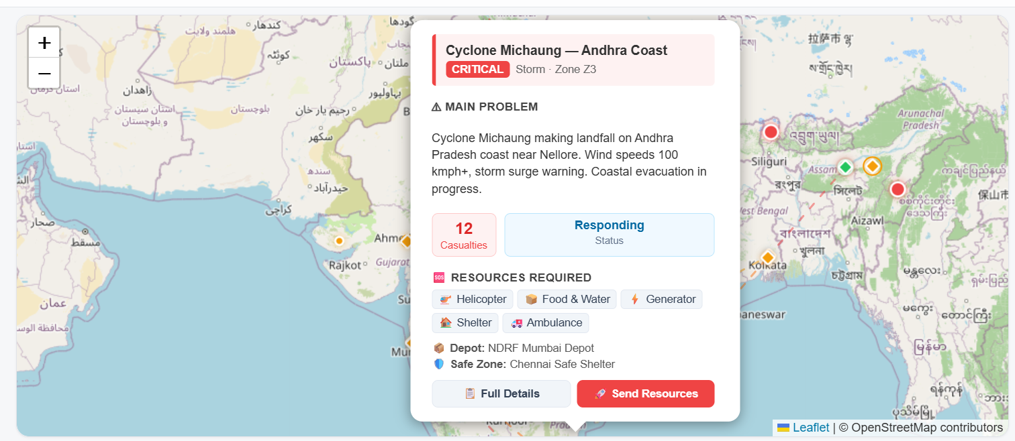
Output

Slide 16
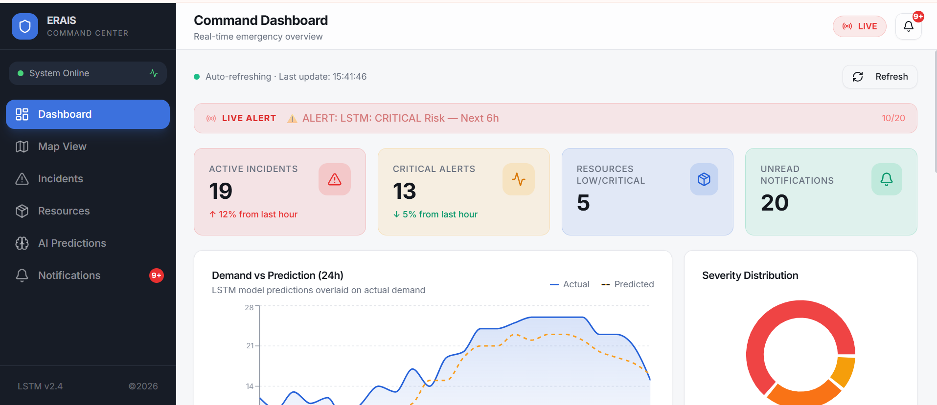
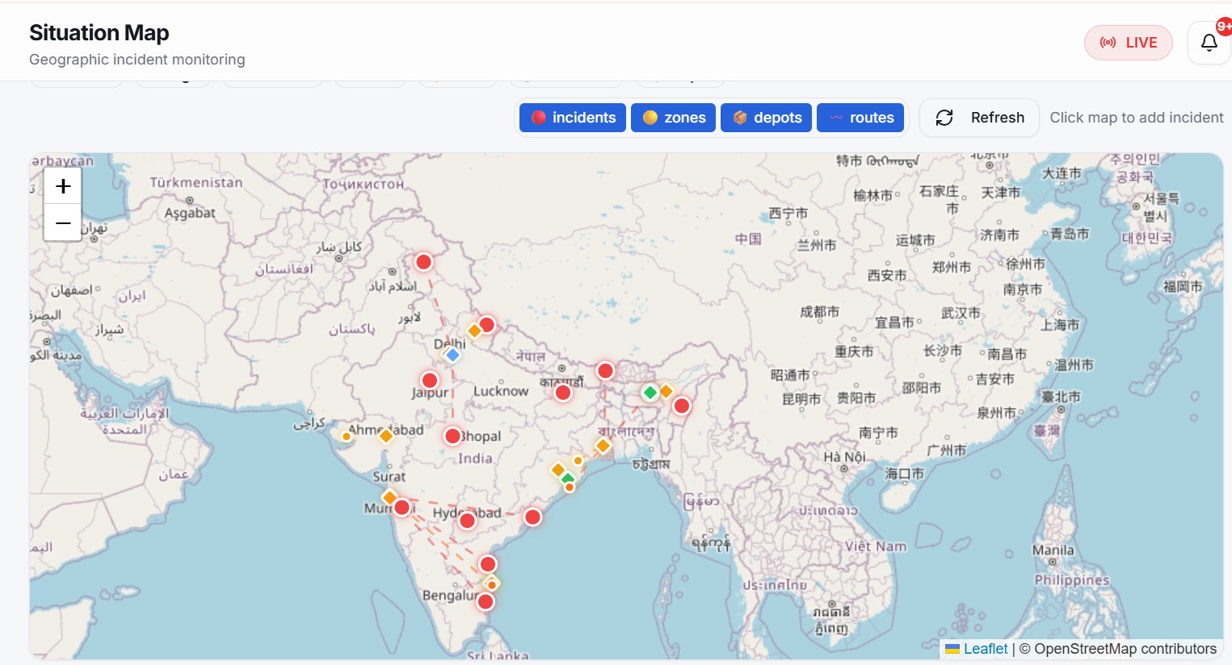
Implementation

Slide 17
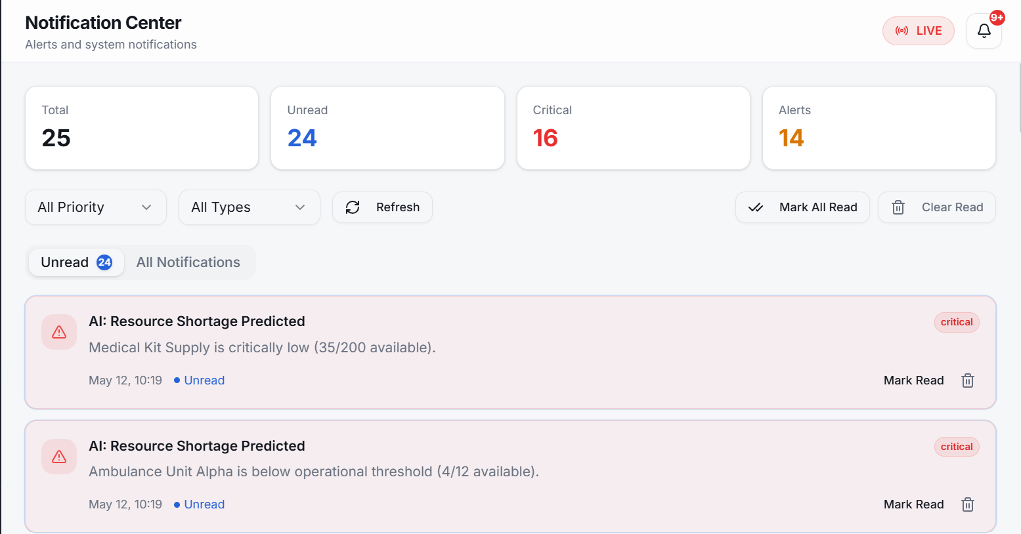
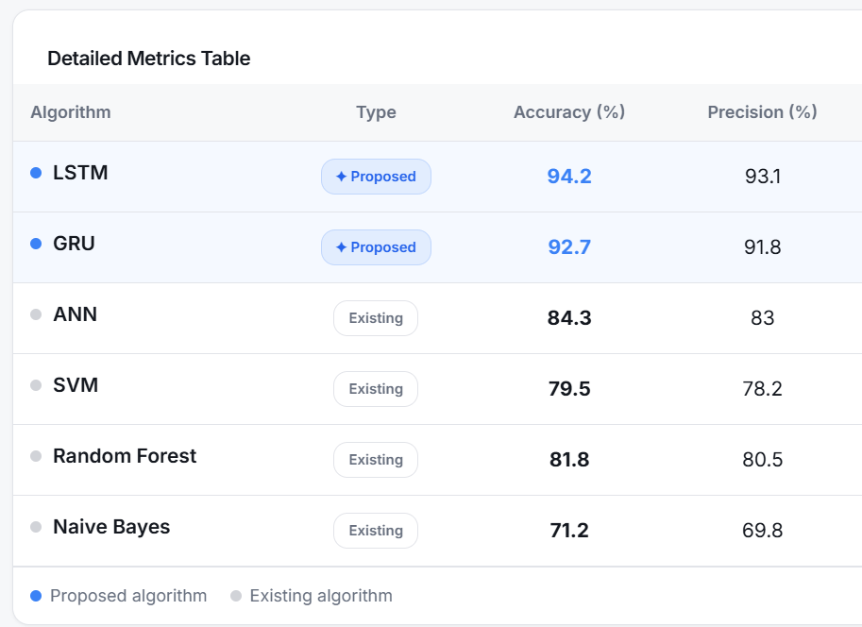
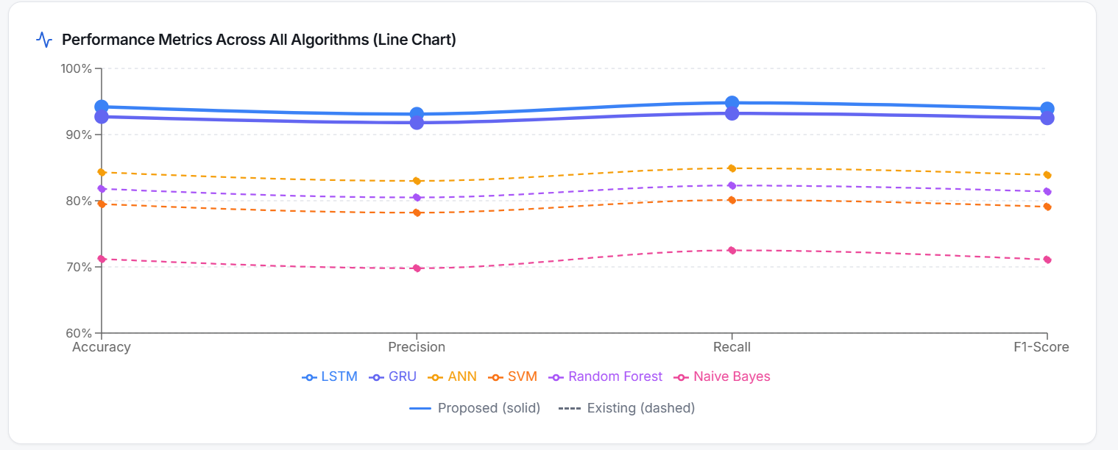

Slide 18

Conclusion
Developed a deep learning-based smart system for emergency resource management.
Integrated LSTM and GRU models for demand prediction and travel time estimation.
Enabled real-time resource allocation and dispatch planning
Implemented IoT-based inventory monitoring for continuous tracking.
Improved response time, efficiency, and decision-making.
Reduced resource shortages and delays in emergencies.
Overall system enhances emergency management and public safety.

Slide 19

Future scope
Integrate live traffic data and maps (GPS/Maps APIs) for more accurate ETA prediction.
Use advanced deep learning models (Transformers, Graph Neural Networks) for improved accuracy.
Develop a mobile application for real-time alerts and coordination.
Expand system to multi-city / nationwide deployment.
Incorporate drone-based emergency delivery systems.
Enhance predictive analytics using larger and real-time datasets.

Slide 20
References
K. Reddy and P. Singh, “Smart Emergency Response System using LSTM and GRU Models,” International Journal of Engineering Research & Technology (IJERT), 2025.
R. Kumar, “Deep Learning-Based Emergency Resource Allocation using LSTM Networks,” International Journal of Computer Applications, 2024.
S. Patel and A. Mehta, “Real-Time Disaster Response System using IoT and Machine Learning,” International Journal of Scientific Research in Computer Science, 2024.
A. Sharma, “IoT-Based Inventory Monitoring System for Emergency Management,” International Journal of Advanced Technology, 2024.
D. Roy and S. Banerjee, “Optimizing Emergency Resource Allocation using AI and Cloud-Based Systems,” International Journal of Cloud Computing, 2024.

Slide 21


